Slide 1


Multi-Threaded Lightweight HTTP Server
Bilal Jawed, M. Maaz, Zeeshan Ahmed & Muhammad Hamza

Slide 2

About Our Project

Slide 3

Key Features
HTTP GET handling
static file serving
multithreading
caching, and request queuing

Slide 4

Objectives
Build a lightweight HTTP server for concurrent requests
Implement caching, metrics logging, and queuing
Test performance with stress-testing tools
Learn OS concepts: threads, mutexes, sockets

Slide 5





System Design
Key Components:
Main Server Loop: Accepts and queues client requests.
Worker Threads: Process requests efficiently.
Cache Module: Stores frequently accessed files in memory.
Metrics and Logging: Tracks server activity and logs errors.
Modular Architecture ensures scalability and efficiency.

Slide 6
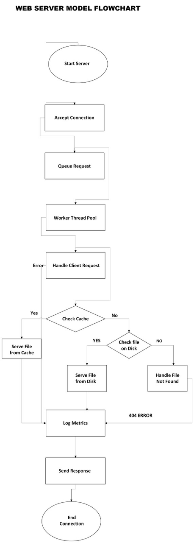

Architecture
Flow of Operations:
Client → Server Loop → Request Queue → Worker Threads → Cache/Response.

Slide 7
Testing
Scenarios:
Normal Load: 100 requests; focus on success rate and response time.
High Load: 500 requests; tested queuing and rejection rates.
Failure Simulation: Handled timeouts and connection errors effectively.
Results:
Multithreading minimized latency.
Caching significantly improved response time.
Queuing prevented crashes under high loads.

Slide 8


Observations
Efficiency:
Thread pool managed concurrent requests effectively.
Reliability:
Request queuing and error handling ensured stability under stress.
Performance:
Caching reduced file I/O, enhancing response times.

Slide 9

Conclusion
Successfully implemented a robust multi-threaded HTTP server.
Applied OS concepts in real-world scenarios.
Demonstrated performance improvements with caching and queuing mechanisms.

Slide 10



2
Any Questions?

Slide 11
Thank You

